Slide 1
Basics of Competitive programming
By: Riham Katout

Slide 2
Introduction
- What is competitive programming?
Competitive programming is a sport where contestants solve algorithmic problems within a time limit using a programming language of their choice. It tests problem-solving skills, knowledge of algorithms, and ability to write efficient code.

Slide 3
It’s benefits:
Problem-Solving and Programming Skills
Technical Interview Preparation
Prizes
Enhances Your Thinking Ability
Unleashes the Ability to Write Better and Optimized Code

Slide 4
Competitive programming problems
Searching
Sorting
Dynamic Programming
Graph Theory
Number Theory
Greedy Algorithm
Backtracking
Divide and Conquer
String Manipulation
Data Structure

Slide 5
Set up your environment
Choose a suitable language, C++ is recommended
Install a good IDE (visual studio, visual code, code blocks are good)
Install required libraries and extensions
Enjoy your cup of tea ☺

Slide 6
How to install IDE
visual studio for C++
visual studio code
codeblocks

Slide 7
Basics of C++

Slide 8
Start by watching these videos
Introduction
First project in C++
Escape sequence
variables vs data type

Slide 9
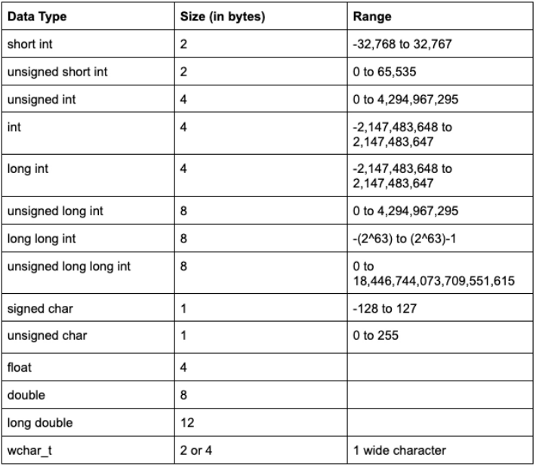
Build in C++ Data Types

Slide 10
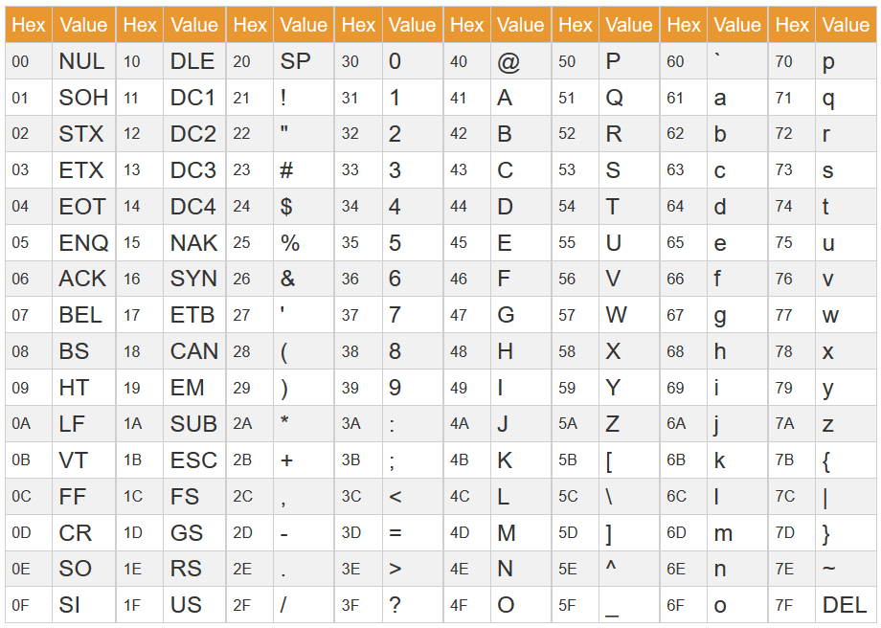
ASCII Table

Slide 11
Videos to watch
Priorities and calculations
Basic Arithmetic & casting
Prefix & postfix compound
Variable scope (local vs. global)

Slide 12
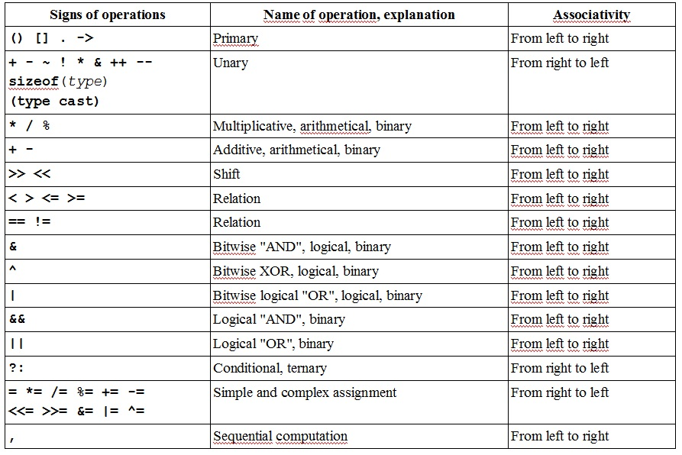
Priorities & Calculations

Slide 13
Solve problems is the best way to practice ☺
It may be hard at the beginning, it’s OK you won’t die ^_^
Remember it’s a new thing so the normal situation is being difficult but you can ask for help in our communities
Palestinian community
Najah National University Community

Slide 14
We’ll solve problems on the following sites
Hackerrank → how to register and use it (at 2:40 min)
Codeforces → how to register and use it
Atcoder → how to register and use it

Slide 15
Basic problems
Hackerrank - say Hello, World!
Hackerrank - print sum
Hackerrank - Data types example
Codeforces - domino piling
Codeforces – drinks // back to it after learn loops

Slide 16
Selection statements
if statement, switch statement

Slide 17
Selection statements videos
if statement
logical operators
switch statement

Slide 18
Selection statements problems
Hackerrank - Conditional statements
Codeforces – watermelon
Codeforces - Soldier and Bananas
Codeforces - Lucky division
Codeforces - Theatre square
Codeforces - Cheap travel
Codeforces - Even odds

Slide 19
Loops
for, while, do-while

Slide 20
Loops videos
While, do-while loops
For loop
Examples of loop, break, continue
Nested loop
Draw shapes (triangle)
Draw shapes (square & some letters)

Slide 21
Loops problems
Hackerrank - For Loop
Codeforces - A+B
Codeforces - Young physicist
Codeforces – Hulk
Codeforces - Vanya and fence
Codeforces - Bear and big brother
Codeforces - Wrong subtraction
Codeforces - Kefa and first steps
Codeforces – Taxi **important
Codeforces - Good array
Atcoder - Find Takahashi
Codeforces - The day of Pi

Slide 22
Functions

Slide 23
Functions videos
Part 1
Part 2
Built in functions
Random function
Call by reference vs. call by value
Recursion 1
Recursion 2
Default arguments

Slide 24
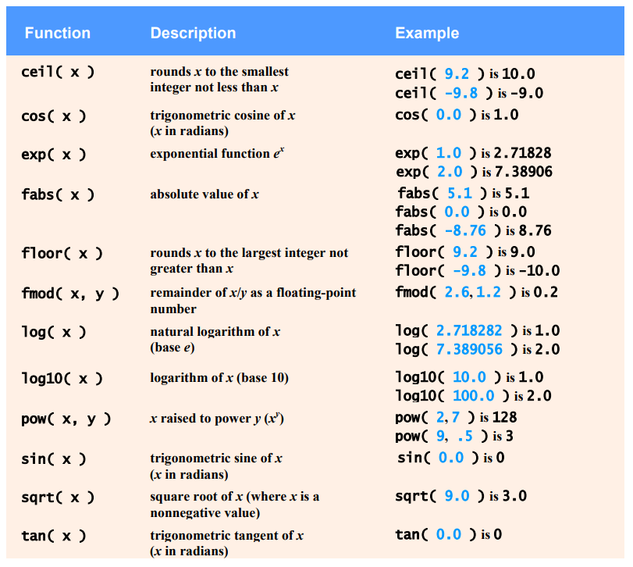
Frequently used built in functions
#include <math> functions

Slide 25
Functions problems
Atcoder – Power
Codeforces - Pens and pencils **ceil function
Codeforces - Extremely round **try to solve it using log10 function
Codeforces - Dreamoon and stairs
Codeforces – Factorial **try to solve it using recursion
Atcoder - A recursive function
Codeforces - Stand-up Comedian ** try to use min, max functions in <algorithm> library
Codeforces - Cardboard for Pictures ** sqrt function

Slide 26
Arrays
1D & 2D

Slide 27
Arrays videos
1D array - part 1
1D array - part 2
1D array - part 3 - passing array to function
1D array - part 4 - array of charachters
2D array

Slide 28
Array problems
Hackerrank - Arrays introduction
Hackerrank - Variable sized array
Codeforces – Puzzles **search for sort function in <algorithm>
Atcoder - Shift
Atcoder - Sequence of strings **try to use reverse function in <algorithm>
Codeforces - Beautiful matrix

Slide 29
Pointers

Slide 30
Pointers videos
Part 1
Part 2

Slide 31
Structure

Slide 32
Structure video
Data Structure - Struct

Slide 33
String

Slide 34
String video
String introduction

Slide 35
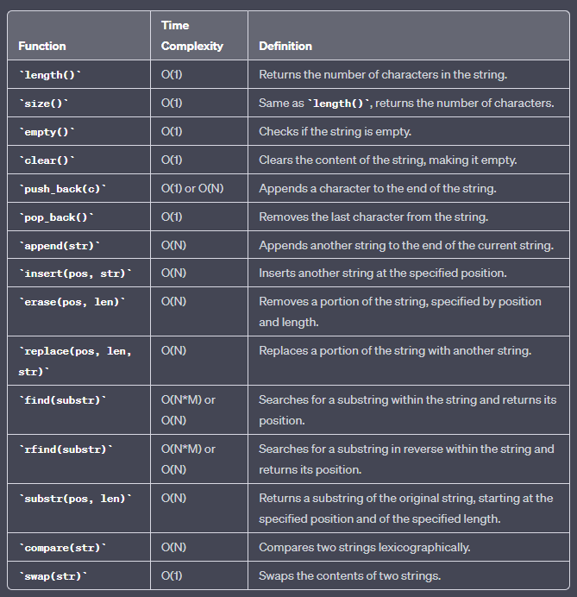
String Functions
Here is the most commonly used functions in <string> library.

Slide 36
String problems
Atcoder - wwwvvvvvv
Codeforces - Anton and Polyhedrons
Codeforces - Way Too Long Words
Codeforces - Queue at the School
Codeforces - Dubstep
Codeforces - String Task **tolower function
Codeforces - Boy or Girl **frequency array
Codeforces – Football
Codeforces - Chat room
Codeforces - Translation
Codeforces - Amusing Joke
Codeforces - Anton and Letters

